Slide 1
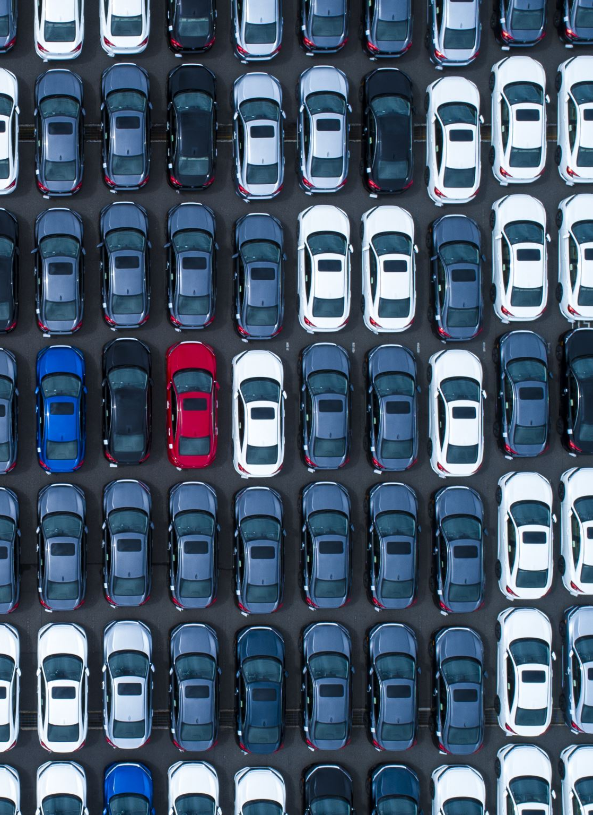
FORECASTING THE VALUE OF PRE-OWNED VEHICLES

Slide 2

INTRODUCING OUR TEAM
Chaitanya Gopinadh Madala
Divya Mamuru
SaiKumar Dacharla
Nikhith Krishna Vinduru

Slide 3
THE PROBLEM
The pre-owned vehicle market is characterized by dynamic pricing influenced by factors such as make, model, age, mileage, condition, geographical location, and market trends. Accurate and timely valuation of used vehicles is crucial for both buyers and sellers in making informed decisions.
This project include dealing with missing or incomplete data, normalizing various data formats, and selecting relevant features that significantly impact the valuation. Additionally, the model should be scalable to handle a high volume of queries in real-time.

Slide 4
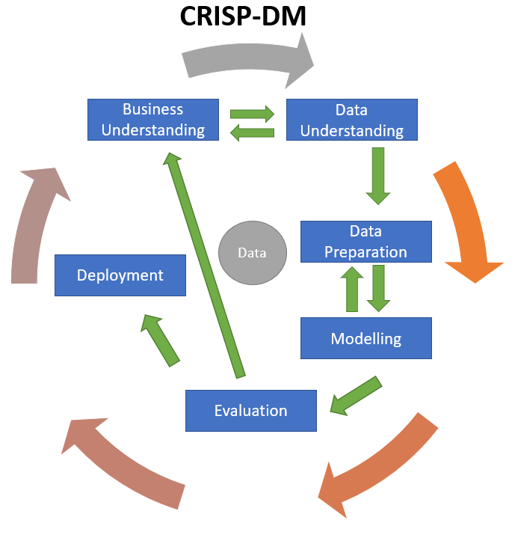

Slide 5
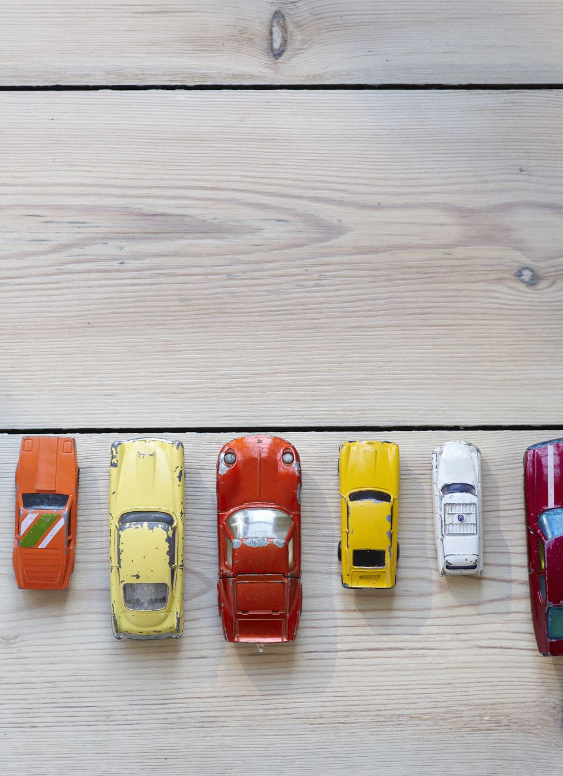
BUSSINESS GOAL
We have to use the provided independent variables to model the cost of cars. The management will use it to comprehend the precise relationship between price variation and independent variables. In order to maintain a set pricing, they can adjust the car's design, the company's marketing plan, etc. The tool will also help management better understand how prices change in a new market.

Slide 6
INTRODUCTION
In an ever-evolving automotive market, accurately determining the value of pre-owned vehicles stands as a pivotal challenge for both buyers and sellers. The dynamic interplay of factors such as make, model, age, mileage, condition, and location intricately influence the market worth of a vehicle. This project embarks on the mission to develop a cutting-edge solution that navigates through this intricate landscape.
By leveraging advanced data engineering techniques and machine learning algorithms, we aim to provide a robust and reliable tool for estimating the value of pre-owned vehicles. This solution promises to bring transparency and informed decision-making to the pre-owned vehicle market, benefitting buyers and sellers alike.

Slide 7
INTRODUCTION CONTINUED…
In this pursuit, we will meticulously gather and process data from a diverse array of sources, including historical sales records, online listings, manufacturer specifications, and real-time market trends. This data will then be transformed into a cohesive format, setting the stage for training our forecasting model.
With a sharp focus on selecting relevant features, we will distill the most essential elements that have a substantial impact on vehicle valuation. These insights, combined with the power of advanced machine learning algorithms, will empower us to construct a model capable of precisely predicting the value of pre-owned vehicles.

Slide 8
TECHNOLOGIES
These are the technologies we are planning to use to achieve the goal.
Python 3.7
Jupyter Notebook
Flask Framework
Random Forest
Aws Cloud
Machine Learning

Slide 9
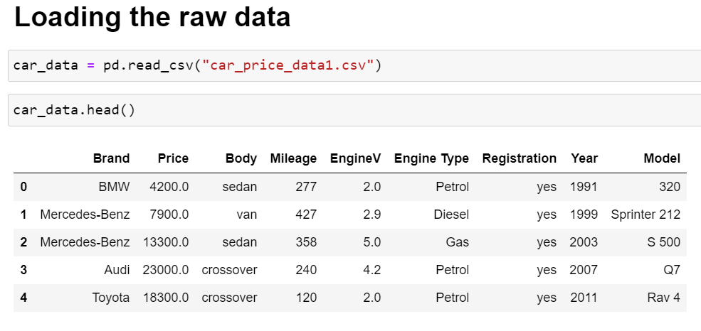
DATASET

Slide 10
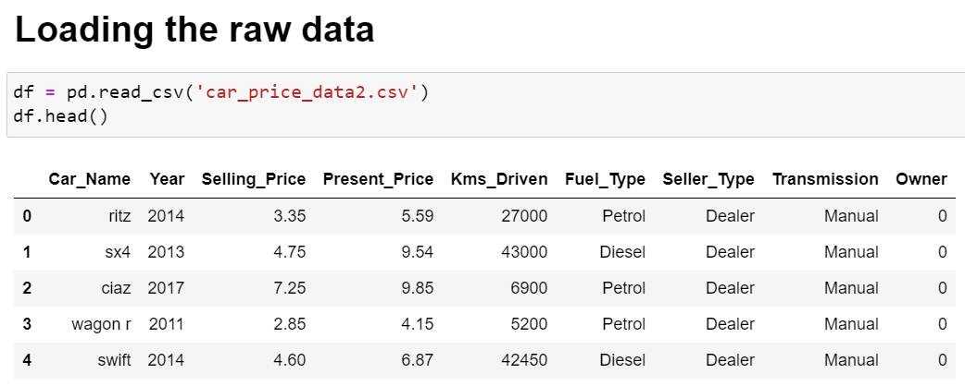
DATASET

Slide 11
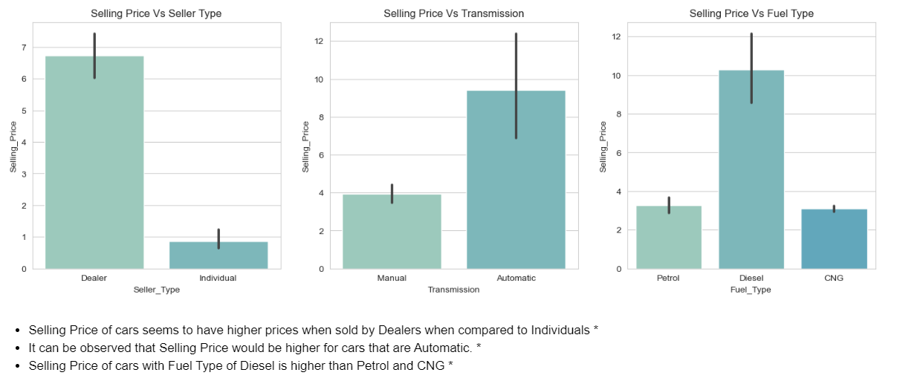
SELLER, TRANSMISSION AND FUEL VISUALIZATIONS WITH SELLING PRICE

Slide 12
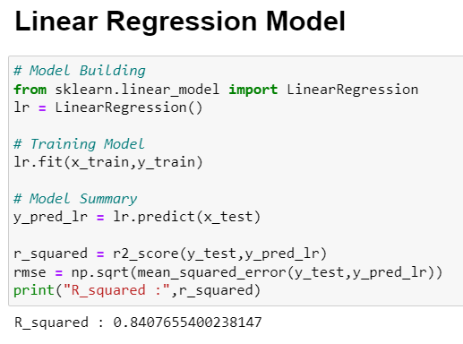

Slide 13
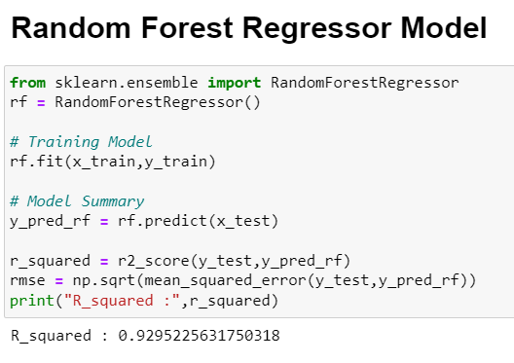

Slide 14
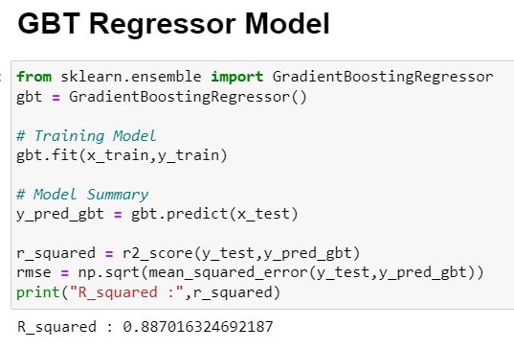
Random Forest Model is giving better Accuracy when compared to other models.

Slide 15
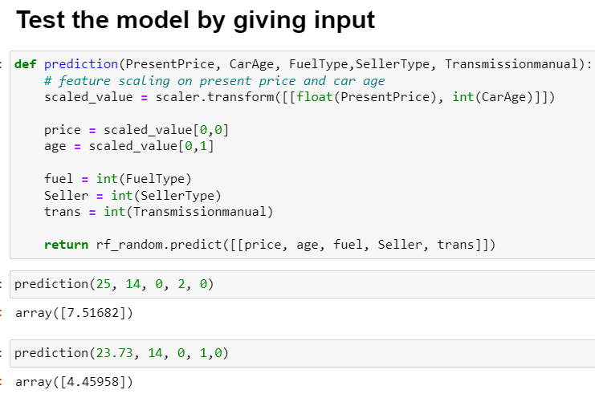

Slide 16
CONCLUSION
1. The current value of a car significantly influences the prediction of its selling price; as one rises, the other tends to increase gradually.
2. The age of a car has a negative impact, with older cars commanding a lower selling price.
3. Cars fueled by diesel exhibit higher selling prices.
4. Manual cars are priced lower, while automatic cars command higher prices.
5. Vehicles sold by individuals generally fetch a lower selling price compared to those sold by dealers.

Slide 17

THANK YOU

